Slide 1
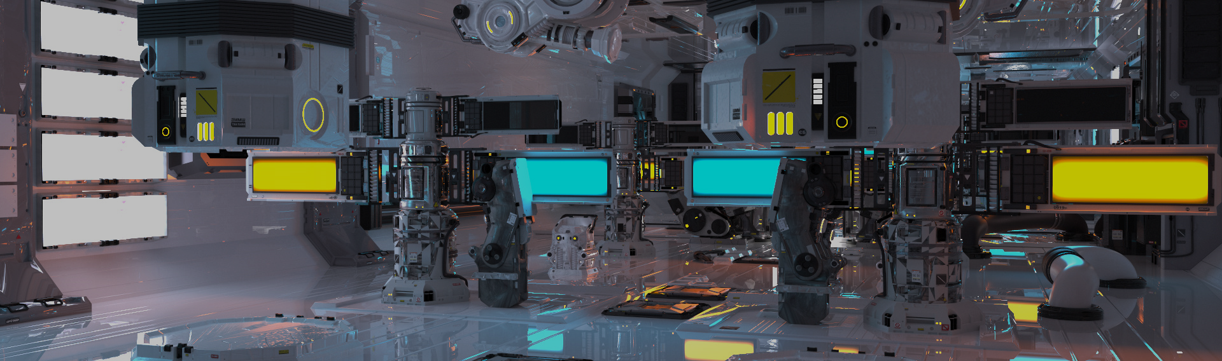
Image processing 1
Computer Graphics Practice
Computer Graphics Lab | NTUST CSIE

Slide 2

Overview
Image Processing
Raster graphics
2D Pixel array
Transform
Quantized
Dithering
Notes:
數位圖像的儲存方式
量化
抖動

Slide 3
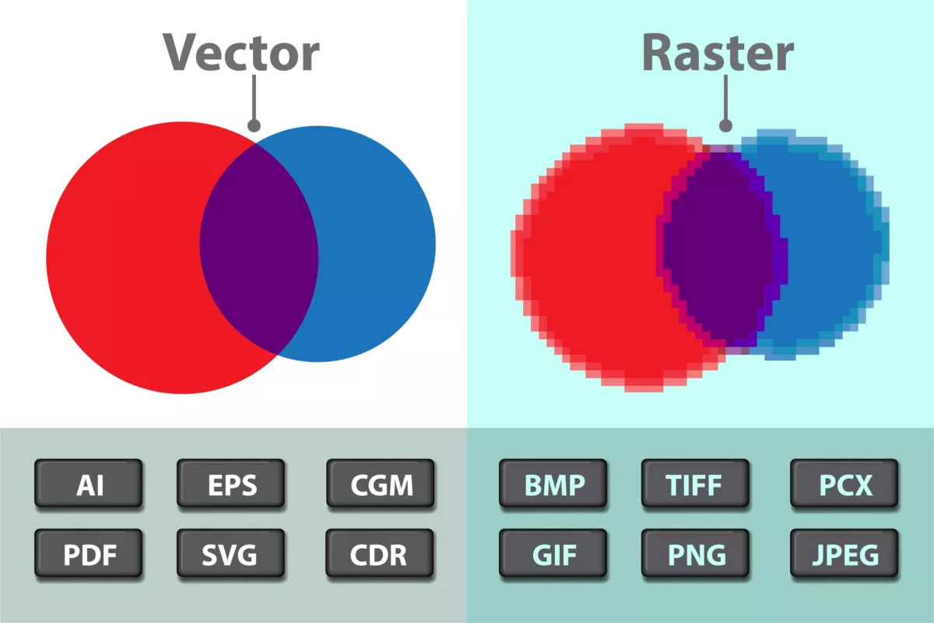
Raster Graphics
Pixel image, also known as a raster image, is an image represented using a pixel array.
Raster, Pixel, Fragment
Uniform and Regular Graph
Fixed neighbor number, Fixed relative
Simple
Channel
Format
jpg, png, tga, hdr…
Color depth (8 bit)
Notes:
Vector: 透過插植方式顯示中間資料，但早期不常使用(計算高)
Raster: 會有失真問題

Slide 4

Raster Graphics
It can be viewed as a three-dimensional array.
Width × Height × channel
for example, a 100-pixel wide and 80-pixel high image would have an array size of 100×80×3.
Since each pixel stores a value between 0 and 255, the total amount of information in the image would be 100×80×3×8 bits.
height
width
channel

Slide 5
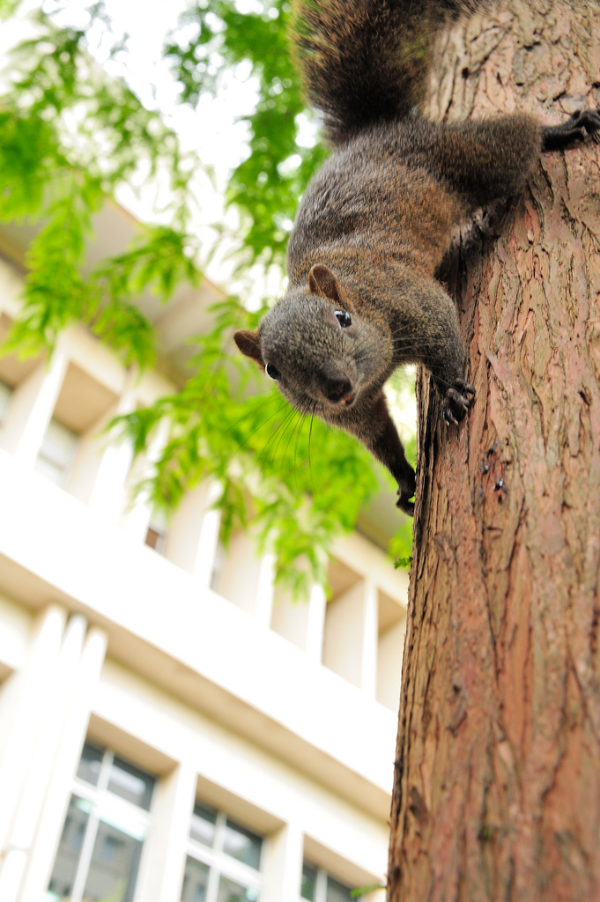
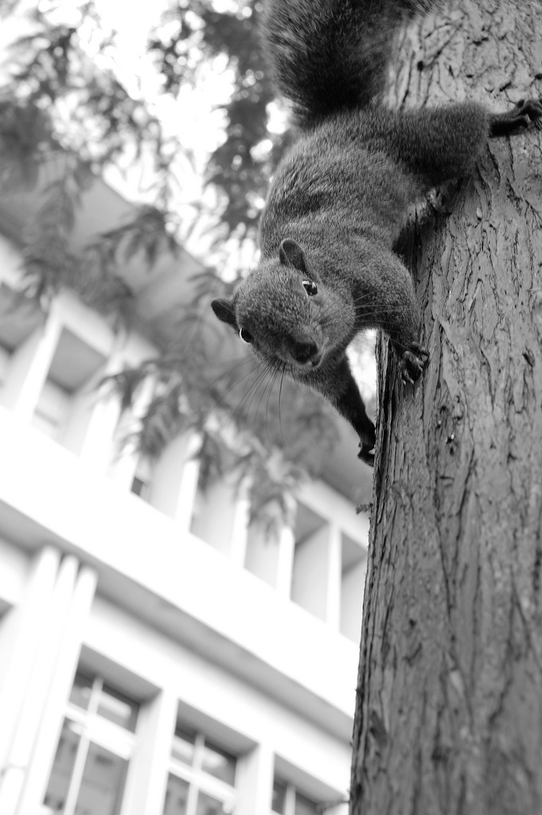
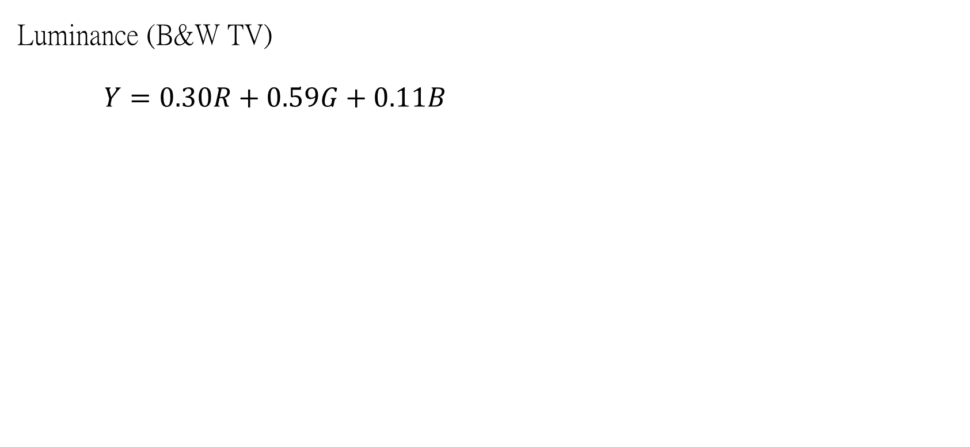
Gray Scale
Luminance (B&W TV)
$Y=0.30R+0.59G+0.11B$
Notes:
Luminance: 亮度

Slide 6
Quantized
Quantization, involved in image processing, is a lossy compression technique achieved by compressing a range of values to a single quantum value. When the number of discrete symbols in a given stream is reduced, the stream becomes more compressible.
Uniform
Populosity
Notes:
量化 會失真的壓縮方式 透過把range內的數值合併至同一個value
Uniform: 大家都一樣範圍
Populosity: 根據出現的次數決定範圍大小

Slide 7
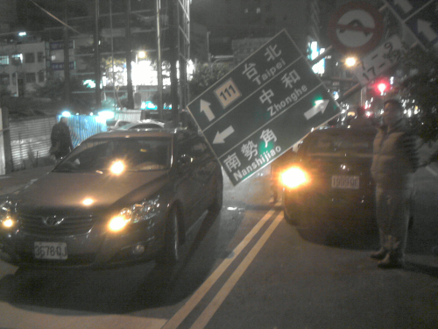
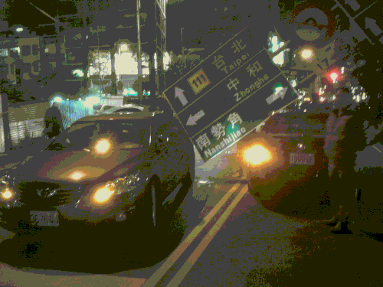


Uniform Quantization
0
1
…
31
32
…
63
…
255
0
1
…
7

Slide 8
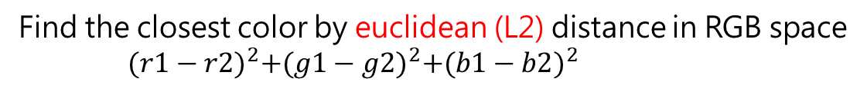
Populosity
uniform quantization
256
256
256
32
32
32
Find 256 most popular colors
1……..256
257……32768
Find the closest color by euclidean (L2) distance in RGB space
${(r1−r2)}^{2}+{(g1−g2)}^{2}+{(b1−b2)}^{2}$
Notes:
目標: 24 bit to 8 bit
步驟:
先將每個通道量化至32種
找到256種出現次數高的顏色
找到最個像素最接近裡面的哪個顏色

Slide 9
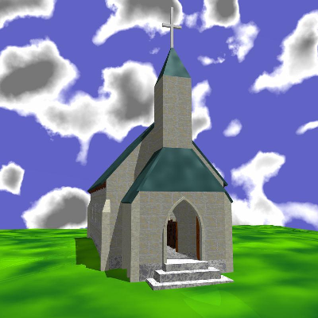

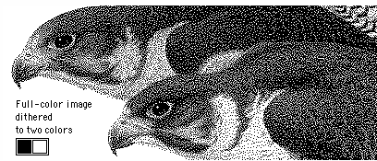
Dithering
Dithering is the attempt by a computer program to approximate a color from a mixture of other colors when the required color is not available.

Slide 10
Dithering
Naive Threshold Dithering
Brightness Preserving Threshold Dithering
Random Dithering
Clustered Dithering
Floyd-Steinberg Dithering
Color Floyd-Steinberg Dithering
Notes:
用途: 在有限的儲存空間(早期限制)內，透過顏色的出現頻率來影響觀看感受，dithering 便是為了減緩其中的不自然性所衍生的應用技術。
Random Dithering: 為了貼近大眾人類的審美觀，刻意破壞 image 的結構換取觀看期的舒適感。
Floyd-Steinberg Dithering: 效果最好
Color Floyd-Steinberg Dithering: 多通道版

Slide 11
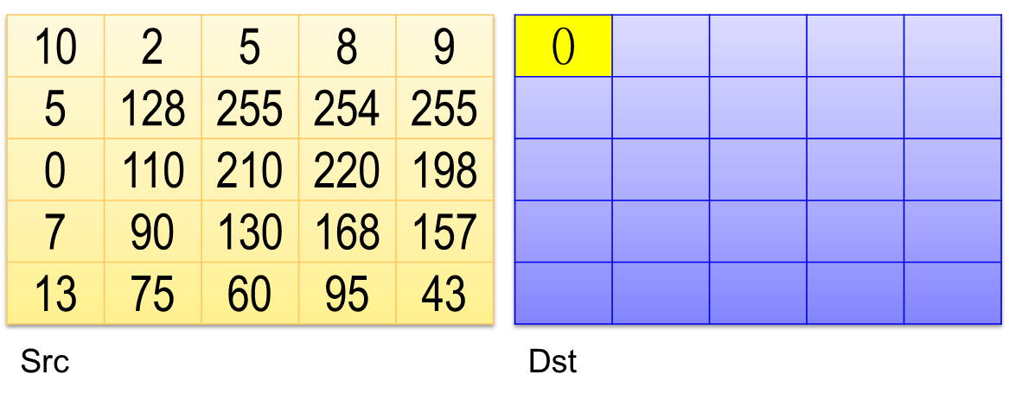
Naive Threshold Dithering (1/3)
Deal with whole image by pixel
Example: threshold is 127, set value to 255 if pixel value bigger than threshold. Otherwise set value to 0
10
Notes:
以0.5作為閥值

Slide 12
Naive Threshold Dithering (2/3)
Deal with hole image by pixel
Example: threshold is 127, set value to 255 if pixel value bigger than threshold. Otherwise set value to 0
10 | 2 | 5 | 8 | 9
5 | 128 | 255 | 254 | 255
0 | 110 | 210 | 220 | 198
7 | 90 | 130 | 168 | 157
13 | 75 | 60 | 95 | 43
0 | 0
2
Src
Dst

Slide 13
Naive Threshold Dithering (3/3)
Deal with hole image by pixel
Example: threshold is 127, set value to 255 if pixel value bigger than threshold. Otherwise set value to 0
10 | 2 | 5 | 8 | 9
5 | 128 | 255 | 254 | 255
0 | 110 | 210 | 220 | 198
7 | 90 | 130 | 168 | 157
13 | 75 | 60 | 95 | 43
0 | 0 | 0 | 0 | 0
0 | 255 | 255 | 255 | 255
0 | 0 | 255 | 255 | 255
0 | 0 | 255 | 255 | 255
0 | 0 | 0 | 0 | 0
43
Src
Dst

Slide 14
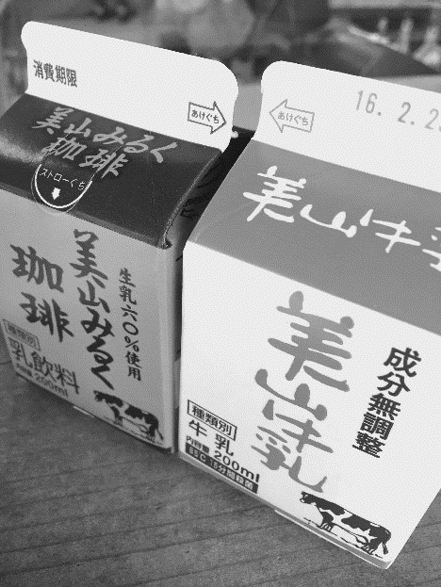

Brightness Preserving Threshold Dithering
Average gray scale
Get threshold
Notes:
以平均亮度作為閥值

Slide 15
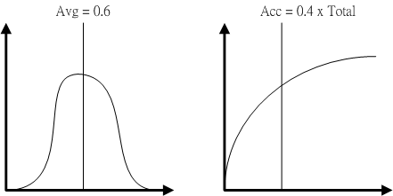
Brightness Preserving Threshold Dithering

Slide 16
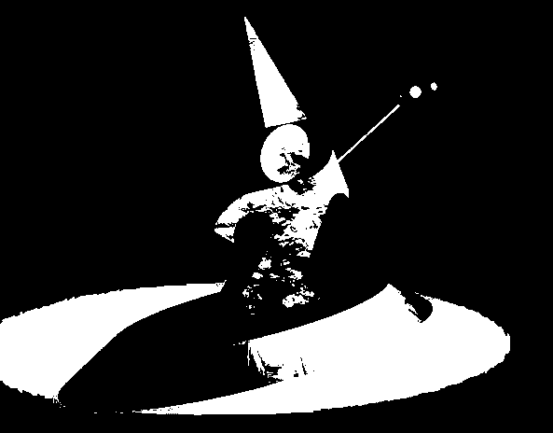

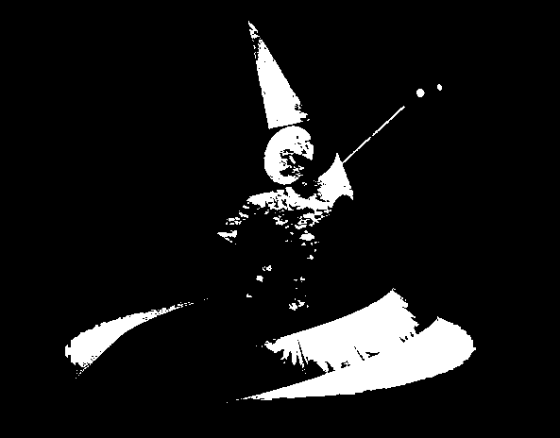

Brightness Preserving Threshold Dithering
Brightness Preserving
Naïve Threshold

Slide 17
Random Dithering
Add a random amount to each pixel before thresholding
Typically add uniformly random amount from [-a,a]
Pure addition of noise to the image
For better results, add better quality noise
For instance, use Gaussian noise (random values sampled from a normal distribution)
Should use same procedure as before for choosing threshold
Not good for black and white, but OK for more colors
Add a small random color to each pixel before finding the closest color in the table
Add random value
[-0.2,0.2]
Notes:
* 閥值可選擇0.5或平均亮度

Slide 18
Clustered Dithering
if: img[x][y] >= mask[x%4][y%4]
0.7059 | 0.3529 | 0.5882 | 0.2353
0.0588 | 0.9412 | 0.8235 | 0.4118
0.4706 | 0.7647 | 0.8824 | 0.1176
0.1765 | 0.5294 | 0.2941 | 0.6471

Slide 19
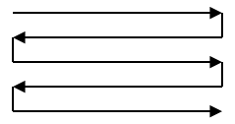
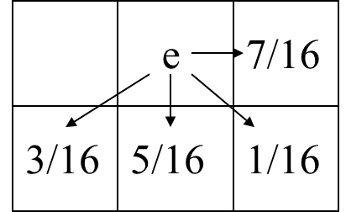
Floyd-Steinberg Dithering
Start at one corner and work through image pixel by pixel
Usually scan top to bottom in a zig-zag
Threshold each pixel
Compute the error at that pixel: The difference between what should be there and what you did put there
If you made the pixel 0, e = original; if you made it 1, e = original-1
Propagate error to neighbors by adding some proportion of the error to each unprocessed neighbor
A mask tells you how to distribute the error
Easiest to work with floating point image
Convert all pixels to 0-1 floating point

Slide 20
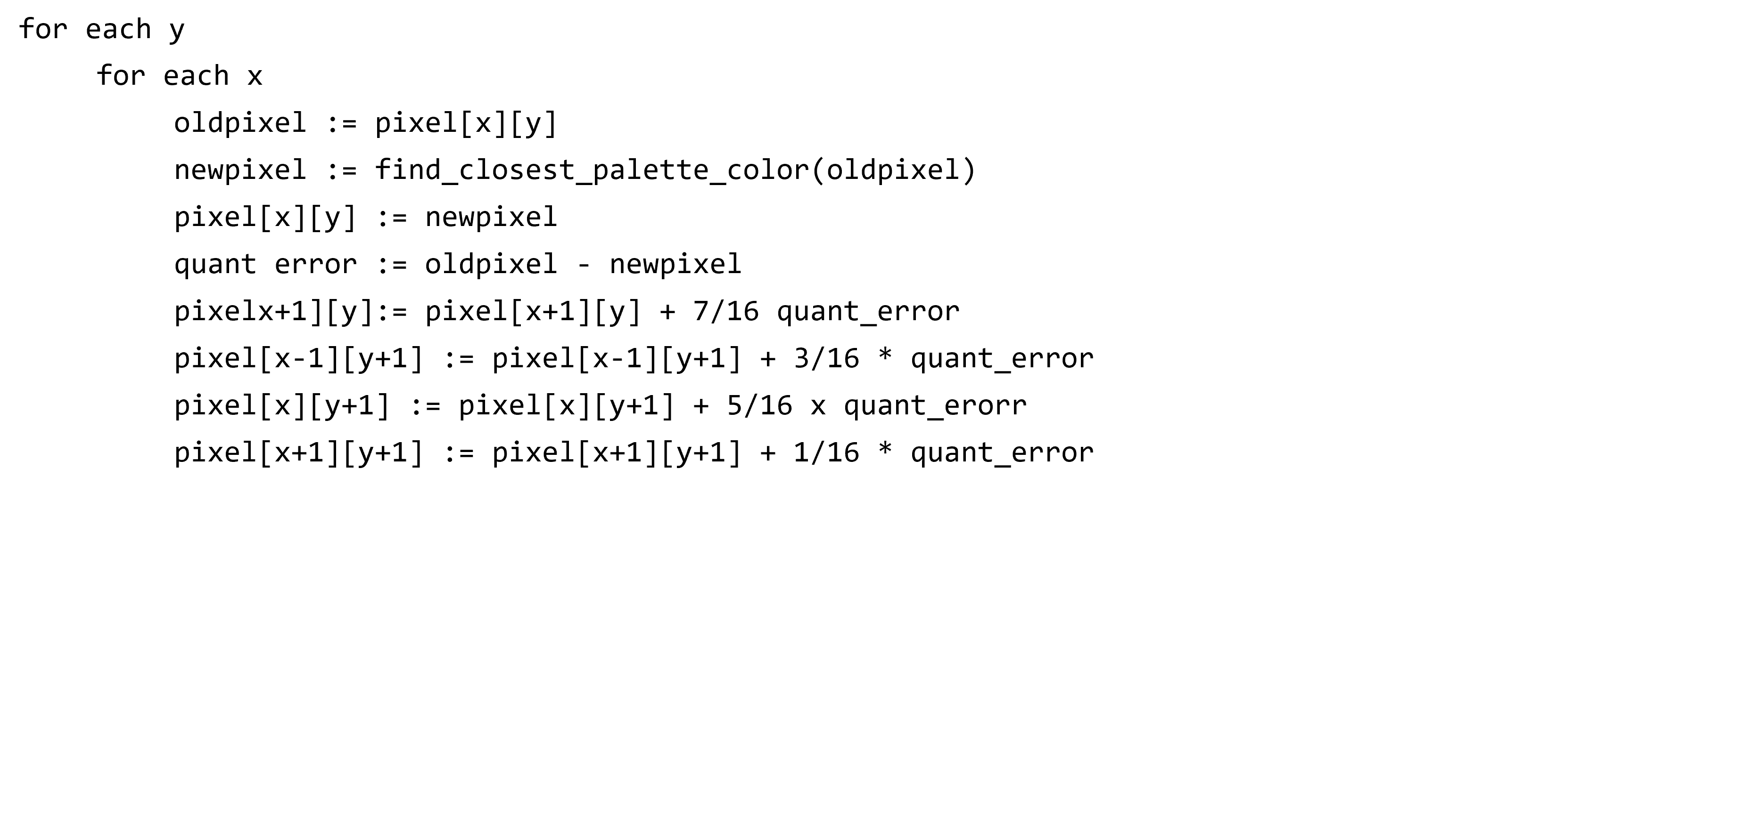
Floyd-Steinberg Dithering

Slide 21
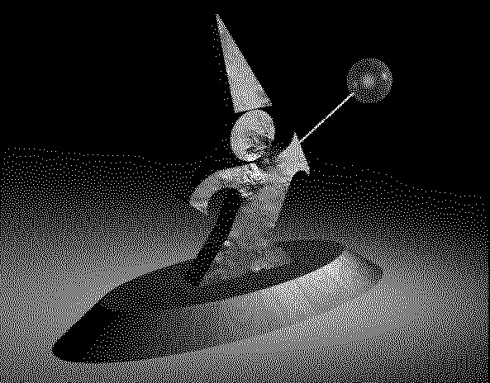
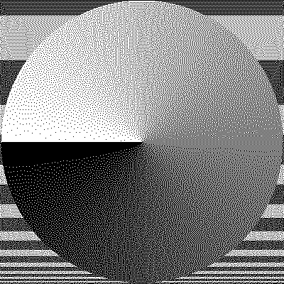
Floyd-Steinberg Dithering

Slide 22
Color Floyd-Steinberg Dithering
All the same techniques can be applied, with some modification
Example: 8 bit framebuffer
Set color map by dividing 8 bits into 3,3,2 for RGB
Blue is deemphasized because we see it less well
Dither RGB separately
Works well with Floyd-Steinberg
Generally looks good
Example is Floyd-Steinberg:
Uniform color table
Error is difference from nearest color in the color table
Error propagation same as that for greyscale
Each color channel treated independently
0
36
73
109
146
182
219
255
0
36
73
109
146
182
219
255
0
85
170
255
7/16
3/16
5/16
1/16

Slide 23
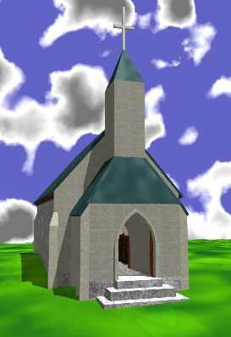
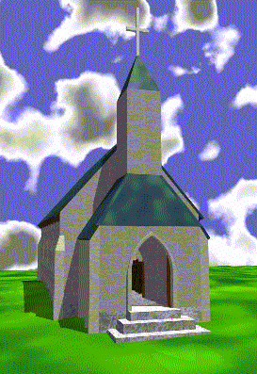
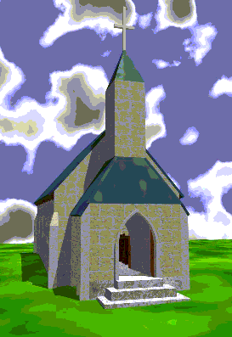
Color Floyd-Steinberg Dithering
Origin
Color Floyd
Uniform Quant

Slide 24
Dithering
Pixel Operations
Block Operations
Neighborhood Operations

Slide 25
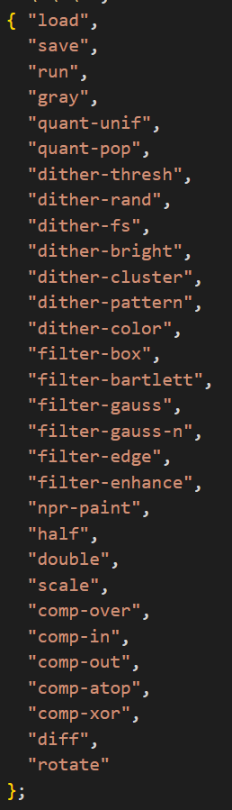
Command
ScriptHandler.cpp
switch (command)
{
case LOAD:
{
if (pImage)
delete pImage;
char* sFilename = strtok(NULL, c_sWhiteSpace);
bResult = (pImage = TargaImage::Load_Image(sFilename)) != NULL;
if (!bResult)
{
if (!sFilename)
cout << "Unable to load image: " << endl;
else
cout << "Unable to load image: " << sFilename << endl;
bParsed = false;
}// if
break;
}// LOAD

Slide 26
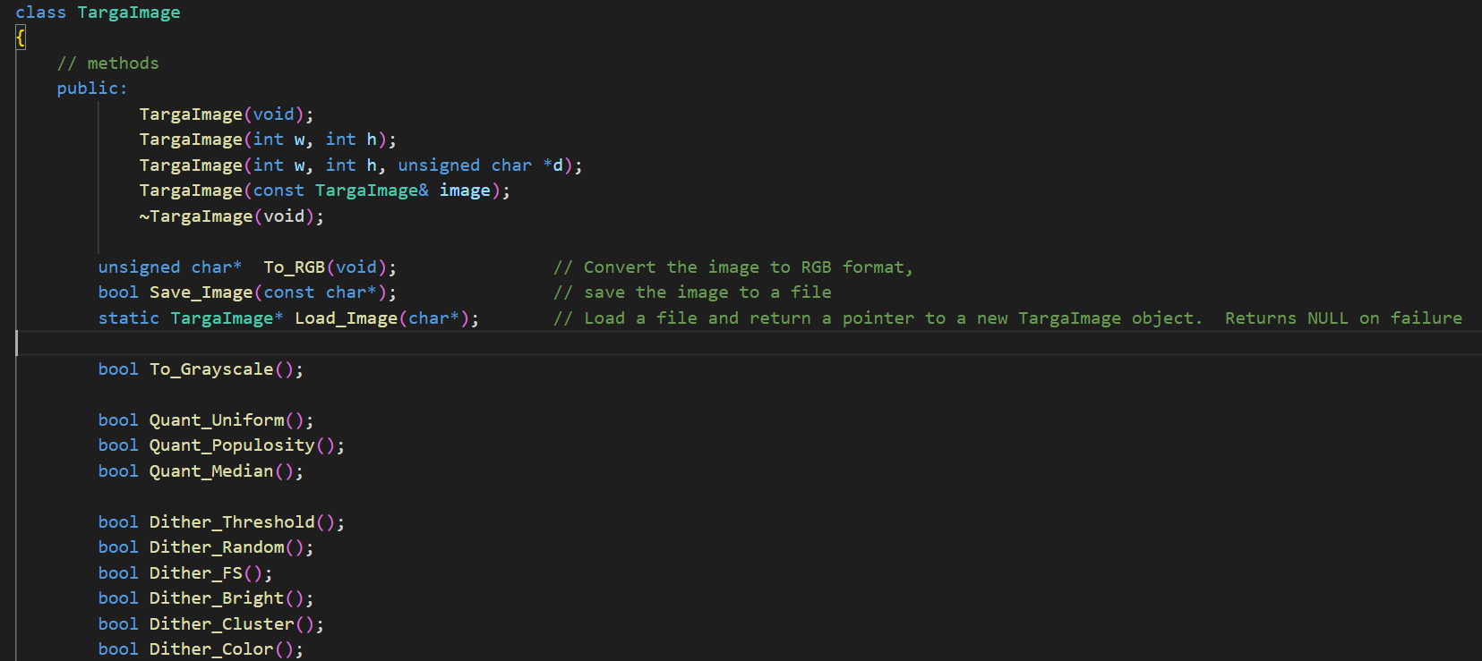
Application
TargaImage.h

Slide 27
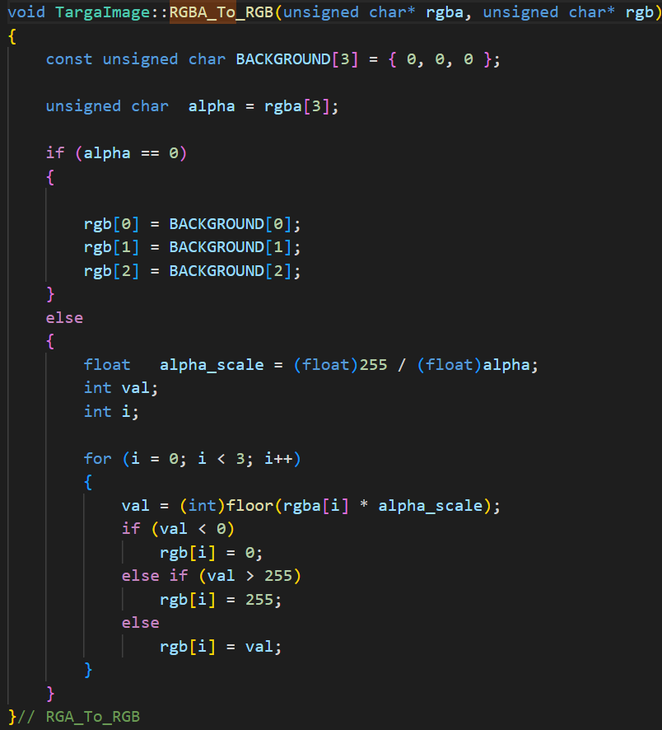
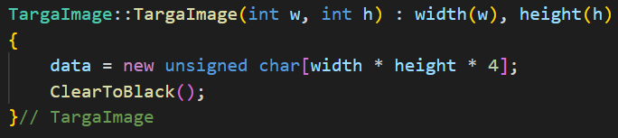
Application
Image
RGBA
8bit each channel
Unsigned char (0~255)

Slide 28
Homework
本次作業開始，未按照上傳格式將扣分!
Grayscale
Uniform Quantization
Use the uniform quantization algorithm to convert the current image from a 24 bit color image to an 8 bit color image.
Use 4 shades of blue, 8 shades of red, and 8 shades of green in the quantized image.
Clustered Dithering
Dither an image to black and white using cluster dithering with the matrix shown below. The image pixels should be compared to a threshold that depends on the dither matrix below. The pixel should be drawn white if: I[x][y] >=mask[x%4][y%4]. The matrix is
Submission Specifications
0.7059 | 0.3529 | 0.5882 | 0.2353
0.0588 | 0.9412 | 0.8235 | 0.4118
0.4706 | 0.7647 | 0.8824 | 0.1176
0.1765 | 0.5294 | 0.2941 | 0.6471

